Slide 1
“Listening with heart” Shaping counselling services to meet client needs.
Presented by: Derek Dempsey
Sure Steps Counselling Coordinator

Slide 2
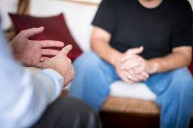
SURE STEPS COUNSELLING SERVICE
WHO ARE WE
Counselling service supporting people vulnerable to homelessness in counties
Dublin Meath Kildare & Wicklow

Slide 3
WE PROVIDE A SERVICE THAT IS
ACCESSIBLE
APPROPRIATE
AVAILABLE

Slide 4
Counselling Services for Homeless People
Client
One to One
Drop In Clinics
Crisis Intervention
Groups

Slide 5
FOUR PILLAR APPROACH
Trauma-informed care using a humanistic approach
Low threshold service for homeless people including those with active addictions
Client-led – meeting the client where they are at both physically and psychologically,
Empowering – focusing on strengths and developing skills and connectedness

Slide 6
ARE WE SUCCESSFUL IN ENGAGING CLIENTS WITH THIS APPROACH?

Slide 7
WHAT CLIENTS SAY
“When you’re on your own you’re a downer to yourself. If you can talk to someone you can feel a bit better about yourself. It’s a friendly conversation with someone” (M)
I believe that counselling has given me a new lease of life and has enabled me to change for the better. I have found counselling to be a beautiful experience and would recommend it to anyone who wants or needs support to help change their lives for the better” (K)

