Slide 1
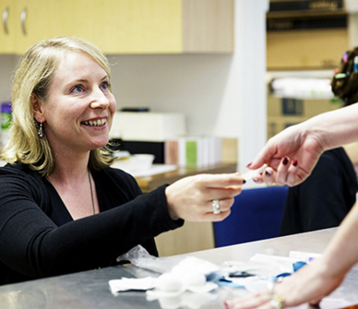
Sydney MSIC
Dr Deirdre Dowdall
Safetynet

Slide 2
Supervised injecting sites
Injecting galleries 1980s – 90s (NY / Sydney)
1986: A café in Berne became the first legally sanctioned drug consumption facility.
1990s: Drug Consumption Rooms open in Germany / Netherlands
2001: MSIC Sydney opens. Scientific pilot project.
2003: Vancouver Insite
2010: Consumption rooms in Denmark, Spain, Norway,
2016: SPOT Boston (Supportive Place for Obs and Tx)

Slide 3
evaluations
1999
2001
2010
2016
3 deaths / day from accidental opiate OD
MSIC opens
KPMG report
Trial status ends
1 millionth injection
No deaths from OD
NSW Dug Summit
History of Sydney MSIC

Slide 4
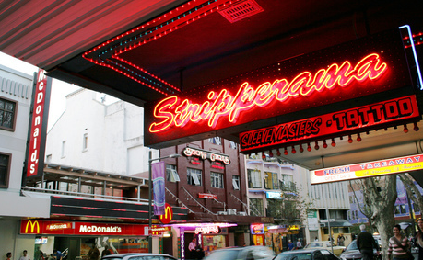
Location

Slide 5
Access

Slide 6
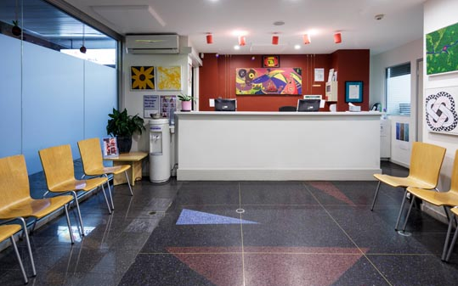
Reception / Assessment
new client
subsequent visits

Slide 7
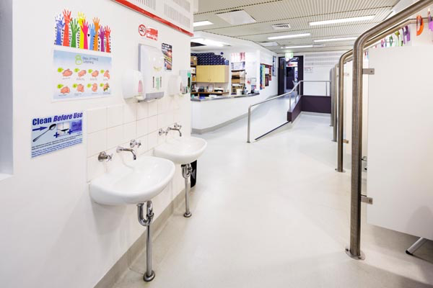
Injecting Room

Slide 8
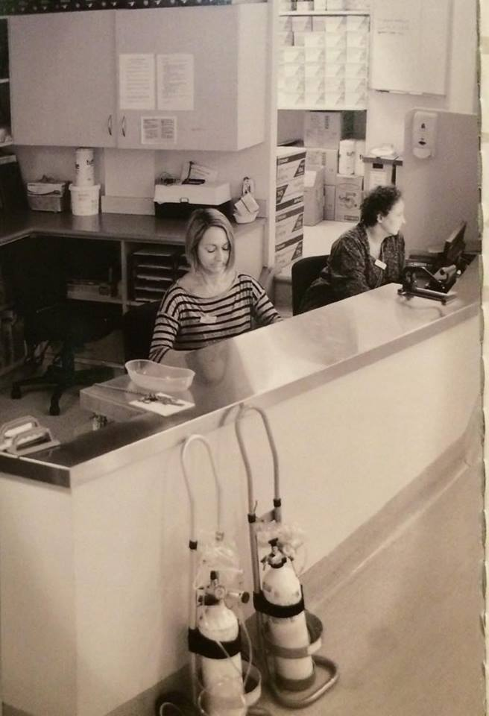
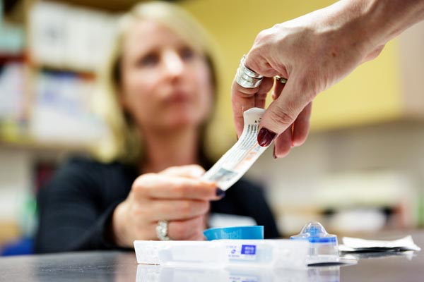
Injecting Area

Slide 9
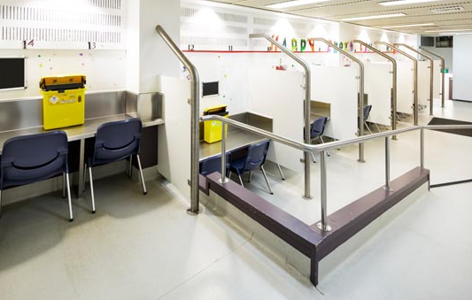
Injecting room
Preparing drugs
Clean equipment
A very personal behaviour
Injecting any pre obtained drug,
heroin, cocaine, prescription pain
killers, amphetamines,benzos
Real time trend data on drug use.

Slide 10
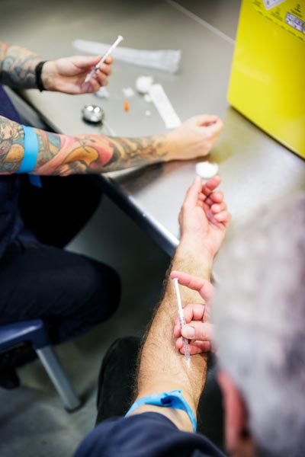
Patients
opiate analgesics
methadone
partner injecting
co-morbidities

Slide 11
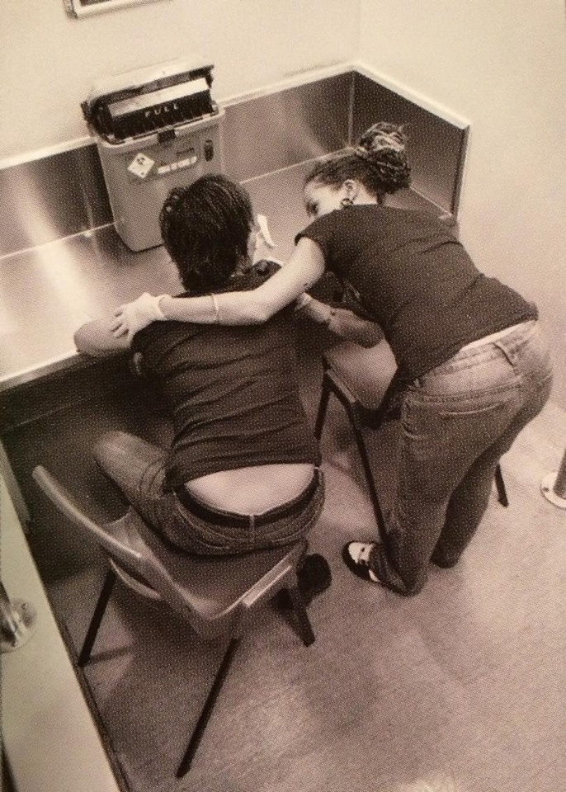
Overdose
“the nod”

Slide 12
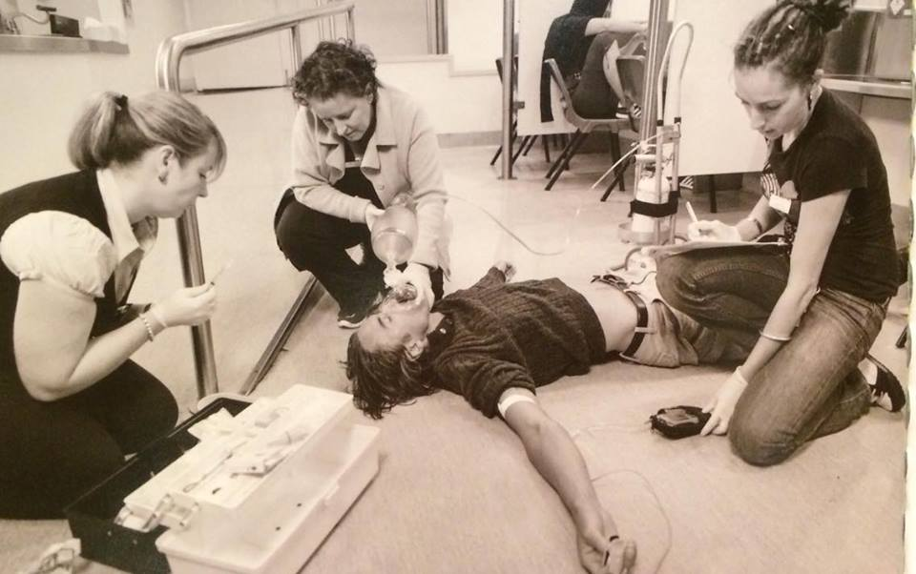
‘the drop’

Slide 14
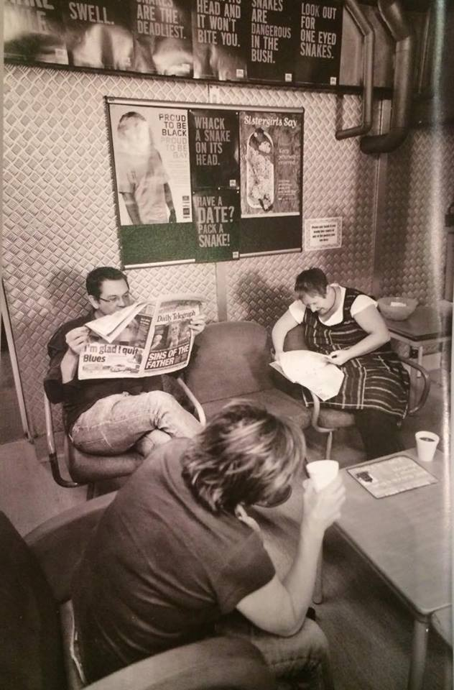
Aftercare
Tea / coffee
Counselling support
Referral pathways
Homelessness support
Social workers
Mental health workers

Slide 15
Initial aims
Reduce death rate from overdose
Reduce virus transmission
Reduce the problems of drug injecting for communities
Provide a gateway to drug treatment and counselling services
Contribute to the body of knowledge re injecting drug misuse

Slide 16
Evaluation
Not proven to reduce overall community deaths from overdose
No effect on virus transmission
Positive effect on public nuisances
decrease in ambulance callouts
decrease in discarded syringes
acceptable to local community and police
Service user benefits:
70% new to services
11,600 referrals on to health and SW services by 2015

Slide 17
Cost
AU $ 2.7 million 2007
Canada: $3million pa

